Slide 1
[Your name]’s [species] project!
Put a few sentences here about your animal(s) that won’t be included in picture captions.
(Ex: their breed, birthdate, etc.)
Put a caption here!
Make sure it’s short, clear, and easily understood. Include the date the picture was taken in every caption.
Your first picture goes here! Make sure your pictures are dated and in chronological order, so this will be the first one taken.
This is caption #2. Be sure that your writing or typing is big enough that anyone can read it without trouble.
Picture #2 goes here. Don’t be afraid to crop your pictures into different sizes and shapes. It’s good to have some variation.

Slide 2
Picture #3 goes here! Make sure your pictures are big enough to see them clearly and tell what’s happening in them.
Caption #3! When you’re designing these pages, make sure they’ll fit right into your project book at the end of the summer. That way, it’ll be less work to re-do then.
Caption #4!
Don’t crowd you captions or pictures. If you don’t have enough room on one page, just move on to the next.
Picture #4 right here! Have some pictures of yourself doing things with your animal. That way, whoever looks at it can see that you were involved and put in the work.

Slide 3
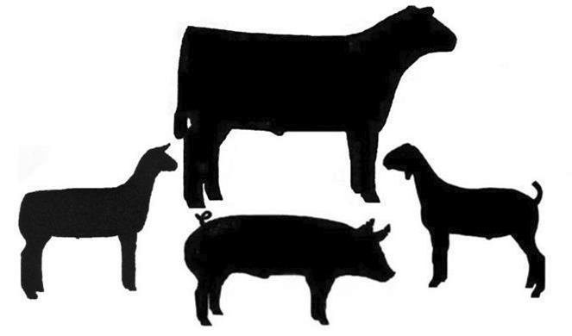
Finally, Picture #5 goes here! Have some funny or entertaining pictures of your animal. Make the timeline interesting for someone to look at.
Remember, you need to have at least five pictures and captions, but feel free to add more if you’d like!
Caption #5! Add some decorations around your pictures if it doesn’t look like they fill up the page. Stickers or drawings are great options.

